Slide 1
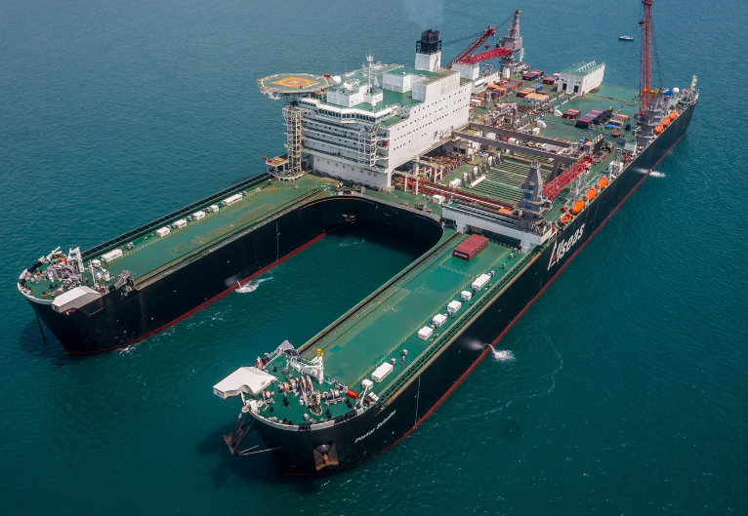
Decommissioning Opportunity for City of Dundee
Ya
Tay Engineering Network, June 2017
Callum Falconer, Chief Executive, Dundeecom

Slide 2
Context UK Continental Shelf Overview

Slide 3
Introduction
UK Continental Shelf (UKCS)
1
Wells
More wells being plugged and abandoned than drilled.
4
Supply Chain
Revenue below £30mm for first time since 2010
EBITDA has fallen by half in last 2 years
2
Assets
More than half of active assets produce <2.5K bbls/day. More assets being shutdown than starting up.
UKCS is fastest declining basin in the world
5
Profitability
UKCS (oil producers) spent £4.2 billion more that it earned in 2014 and 2015.
Deficit was £2.7billion in 2016
Rate of return was 0.2% in 2016 (50% in 2011)
3
Tax
£330 billion paid in corporation tax since production began
In 2016, tax rebates for decommissioning were greater than tax revenues.
6
Decommissioning Costs
Current estimate is ~£70billion.
85% costs estimates are class 5
80% of decom spending will be done by 10 companies.
Decom costs are ~ 2% of global capital budgets.

Slide 4
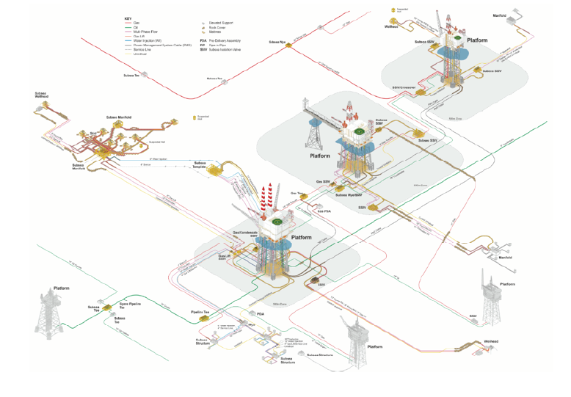
Typical Large Integrated UKCS Field

Slide 5
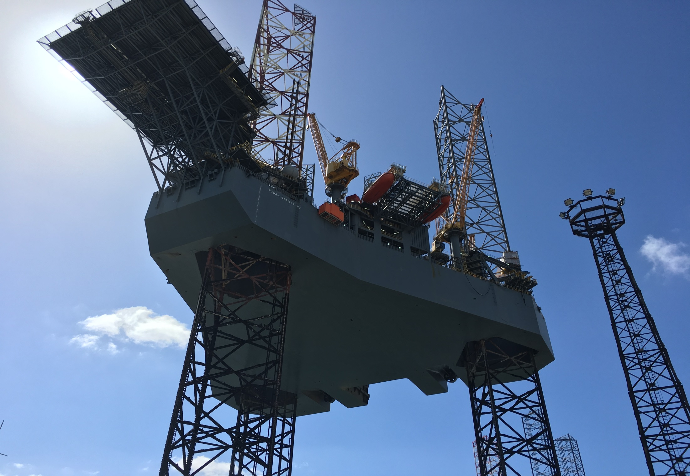
The Market Scale, Segments & Trends

Slide 6
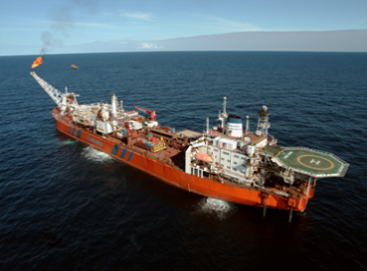
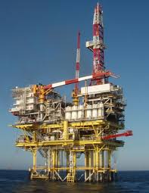
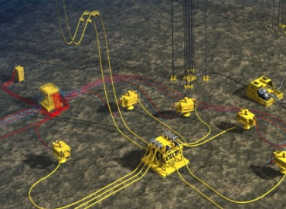
Market Segments
Floating Assets
14%
FPSO’s & Production
Semi-Subs
39%
Platforms & Jackets
Structures
47%
Umbilical's, Mattresses, Wellheads, Buoys
& X-mas Trees
Subsea
There are three market segments within the decommissioning industry, each segment has different requirements, contracting strategies and activity volumes.

Slide 7
Market Scale
Analysis
There will be 326 fields sub economic by 2030 with an estimated decommissioning spend of £70 billion of which onshore expenditure could make up £1.44 billion. The Northern North Sea will account for 22%, Central 43% and Southern around 35% of this activity.
Segment Breakdown
Location Breakdown
47%
39%
14%
Subsea
.
Structures
Floating Assets
Northern
Central
Southern
154 Fields
127 Fields
27 Assets
72 Fields
140 Fields
114 Fields

Slide 8
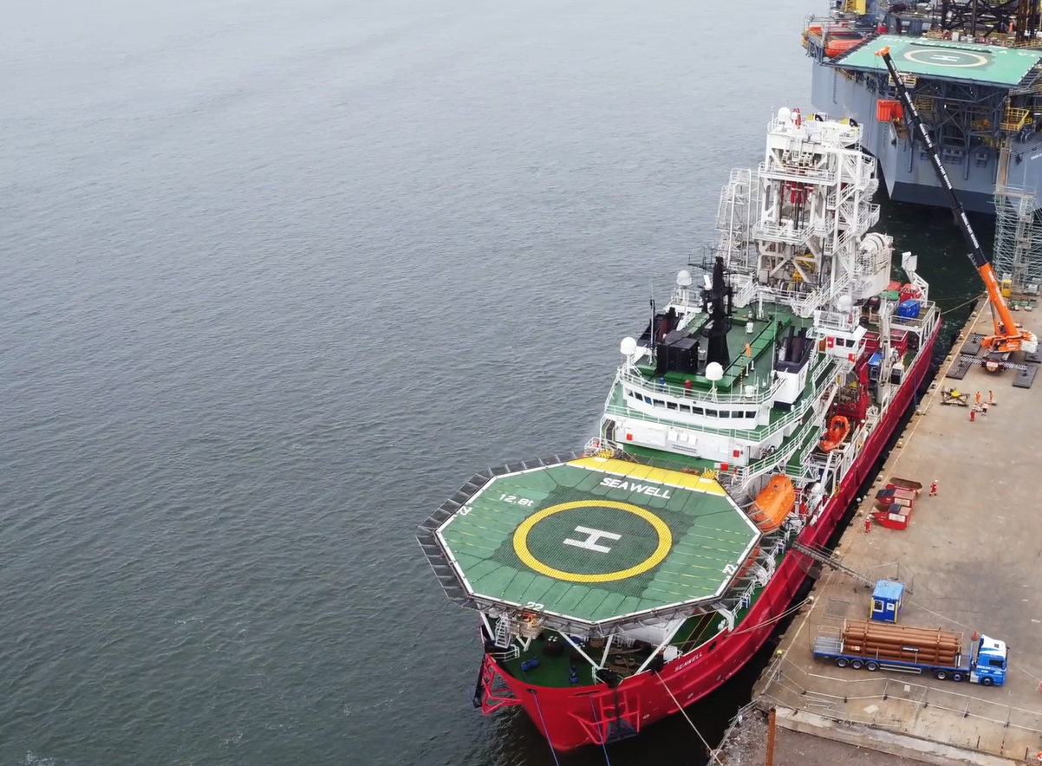
Strategy Implementation Business Development, infrastructure & Supply Chain

Slide 9
Strategy Implementation
Contracting Strategy
Develop a contracting strategy
Supply Chain Development
Build a supply chain that can meet market requirements and exceed expectations.
Business Development
Operator & Tier 1 Contractor engagement. Political involvement and policy development
Infrastructure Development
Build the infrastructure
Business Development Plan
Infrastructure
Progress
Supply Chain Development
Contracting Strategy
Implementation
Market Entry
Strategy
Development from Market Requirements.

Slide 10
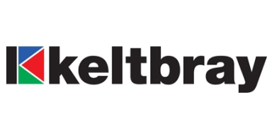
Supply Chain Development Map
Skills
Infrastructure
& Equipment
Supply Chain
Handling Equipment
Onshore Yard Operators
Onshore Yard Space
Ports & Harbour Operators
Quayside Strength & Extent
Waste Material Characterisation
Waste Reuse & Recycling Contractor
Onshore Environmental
Hazardous Material Management & Disposal
Waste Management
Civil Contractor
Onshore Dismantling
Cutting Equipment
Demolition Contractor
Engineering Consultants
Onshore Cranage
Handling Equipment
Metal Recycling Facilities
Waste Reuse & Recycling Contractor

Slide 11
Market Differentiation
Infrastructure
Waste Management
Forth & Tay Decom
Port Services
Infrastructure
Forth Ports Portfolio
The capability of the new Dundee ultra heavy lift quayside is unrivalled in the UK.
The new decommissioning facility in Dundee is complemented by the Deepwater anchorages in the Forth and Leith & Rosyth capability.
Waste Management
Port Services
The introduction of a NORM decontamination and waste transfer facility in Dundee is a market differentiator. This enables a one stop shop to be provided in Dundee.
The largest permanently based quayside craned (1500t) will be located on the quayside. This will enable subsea equipment to be unloaded from vessels that do not have the onboard crane capability.
A fleet of forklifts, Port Service Operators and Marine Services all add to the offering.
Three Ports, Two Estuaries one integrated solution is the offering to all the markets. However the supply chain offering in Dundee exceeds anything any of the Scottish Ports can offer. In particular the availability of 60acres of space and a quayside that can be loaded to 45,000tm along with the capability to offload large reels or components from vessels directly into an on-site NORM decontamination facility using a 1500t crane.

Slide 12
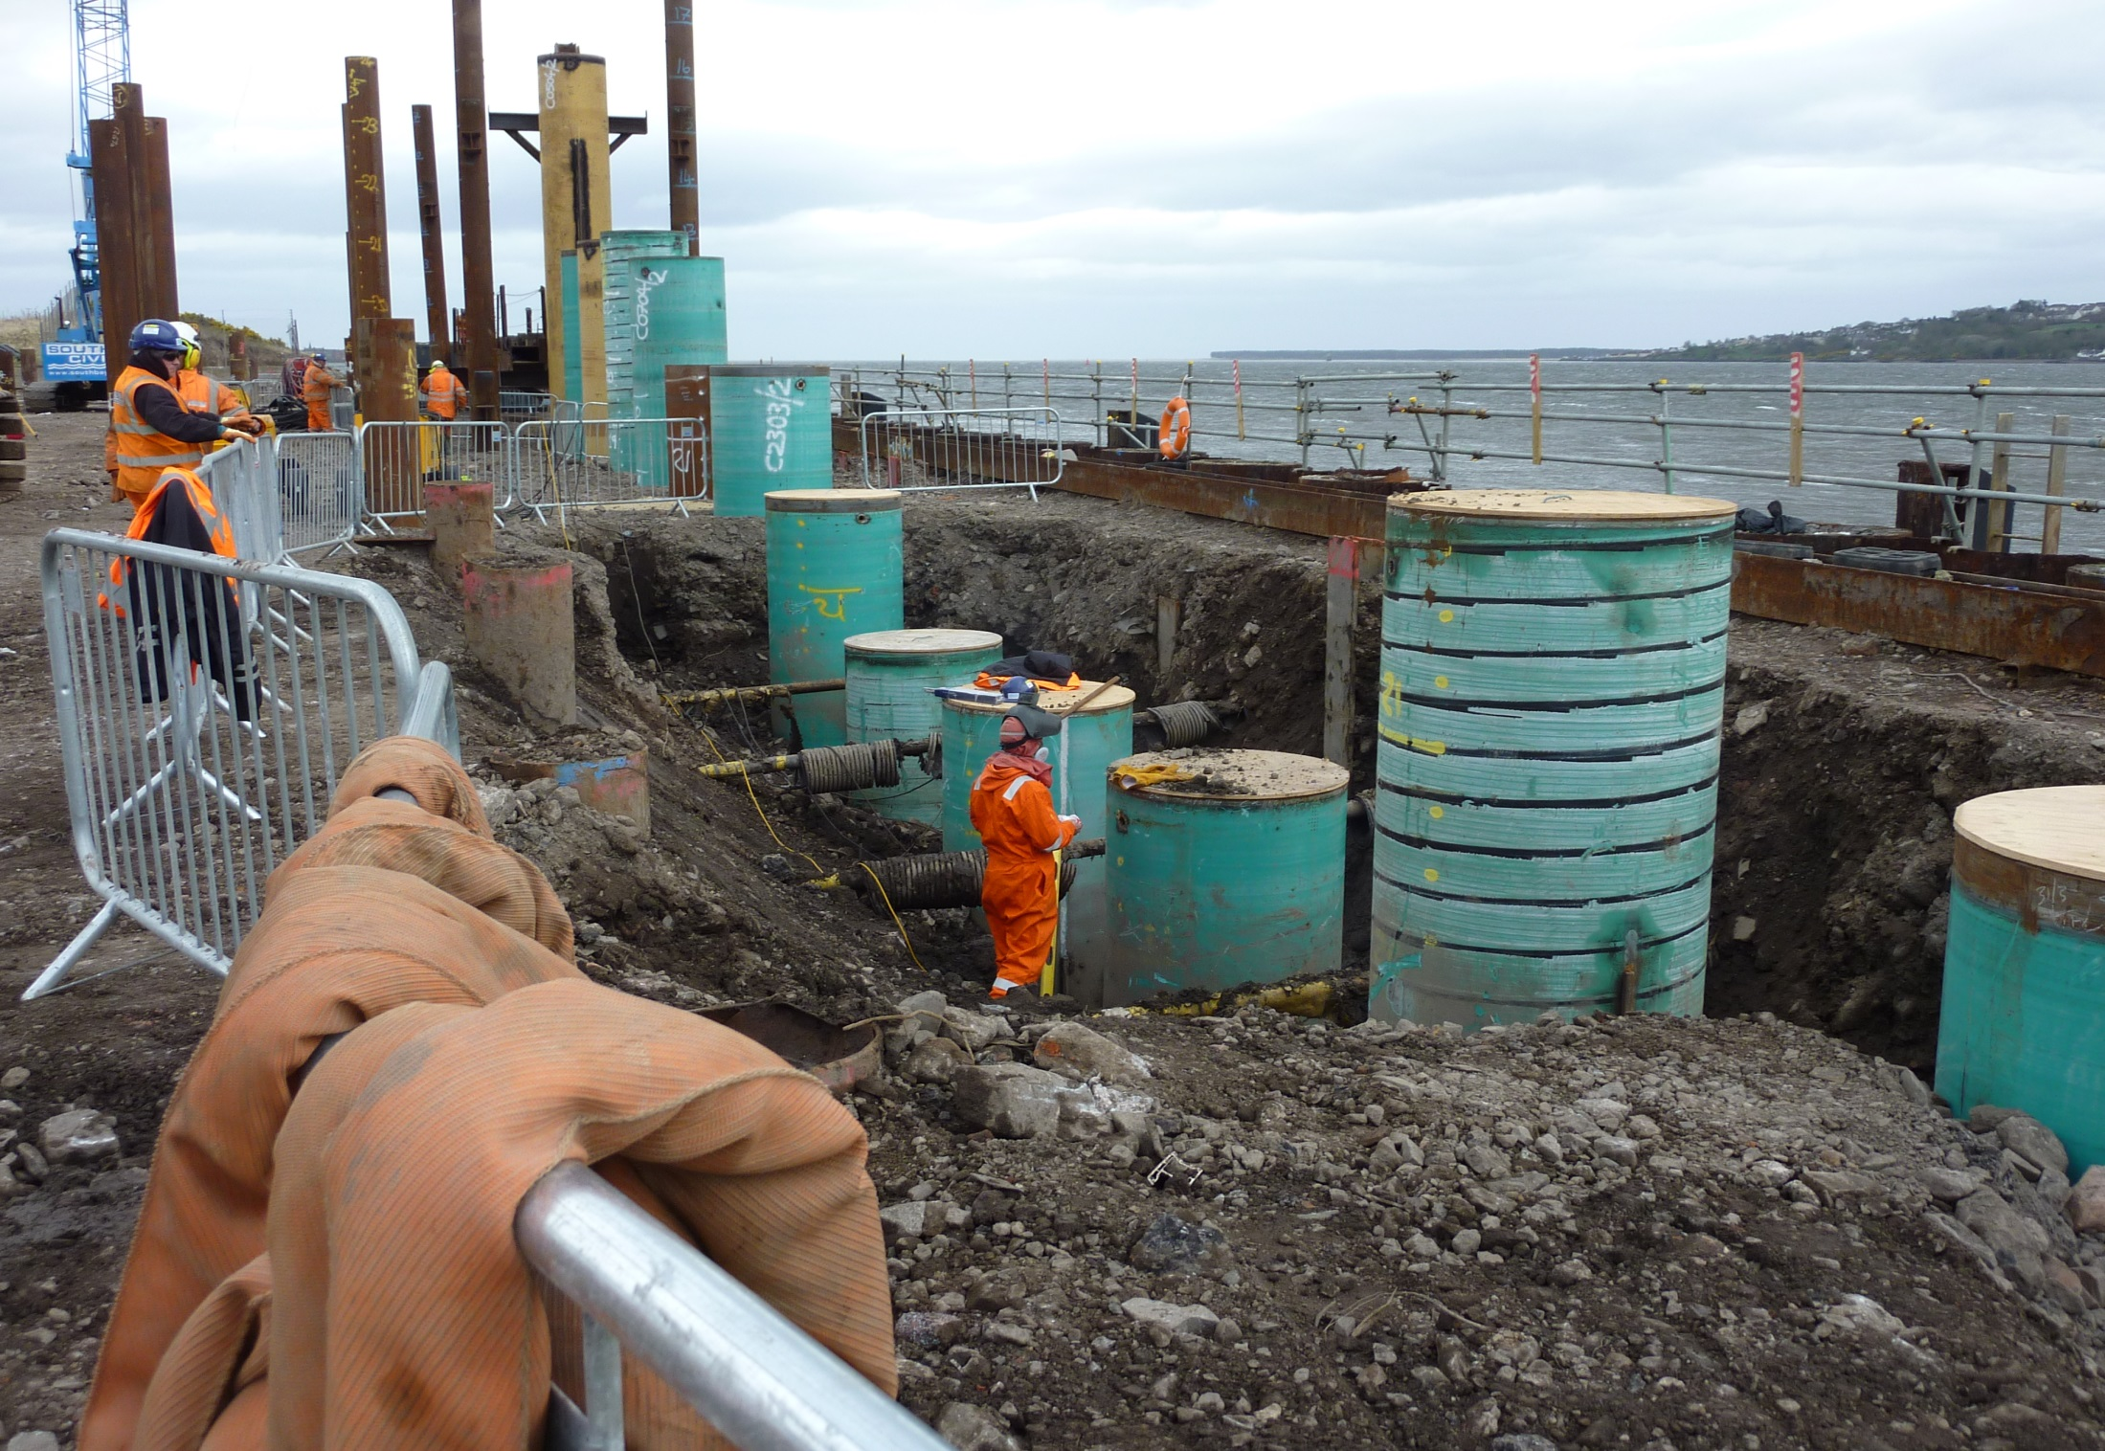
Attracting Business Contracting Strategy

Slide 13
Customer Contracting Strategy
Structures
Subsea
Floating Assets
The Operators use an Engineer, Procure, Remove and Dispose contracting strategy (EPRD). This is a contract that has a single contractor with full responsibility for the project.
The Operators award a single contractor the project using a LOGIC Contract. LOGIC currently supports a suite of 10 standard contracts that are available for use throughout the oil and gas industry.
The Operators primarily aim for a Sale Contract. However this may not be possible depending on the level of contamination and the scrap value. There is significant overlap into ship recycling.
1
Heavy Lift Vessel Owner
1
Construction Vessel Owner
1
Ship Recycling Yard
2
Demolition Contractor
2
Waste Management Company
2
Recycling Yard – Demolition
Tier Level
3
Waste Management Company
3
Integrated Logistics Company
2
Recycling Yard – Waste Management
4
Port Operator
4
Port Operator
2
Recycling Yard – Marine Division
The main synergy between all of the market segments is that the Operator will only contract with a single entity. It is unlikely that an EPRD contract will be split into its constituent parts. There will also be movement on a project or scenario basis as to the tier 2 to 4 configurations; Tier 1 will be subject to highest cost risk in the project and thus the vessel owners will always default into this position.

Slide 14
Contracting Strategy
The progress to date has been focused on developing the capability to bring to the market an Onshore Disposal Yard.
The reality is that this offering will contract with a Tier 1 vessel owner.
The Operator contracting preference is to issue a single disposal contract. This strategy is continued down through the supply chain.
Waste Management Company
Augean North Sea Services
Port Operator
Forth Ports Scotland
Dundeecom
Customer
Tier 1 Vessel Owner
Demolition Contractor
Keltbray or Ship Recycler
Crane Operator
Oilmac
The challenge is how to bring a single offering from multiple companies

Slide 15
Contracting Options
Option 1
Forth Ports is principle contractor to Tier 1
Option 01
Option 02
Option 2
Commercial Consortium
or New Company
Option 3
Supply Chain leads, Forth Ports is a Tier 3 or 4
Option 03
Option 4
Align with an Existing Tier 1 Market Player
Option 04
Option 1
Risk/Reward
Option 2
Risk/Reward
Option 3
Risk/Reward
Option 4
Risk/Reward

Slide 16
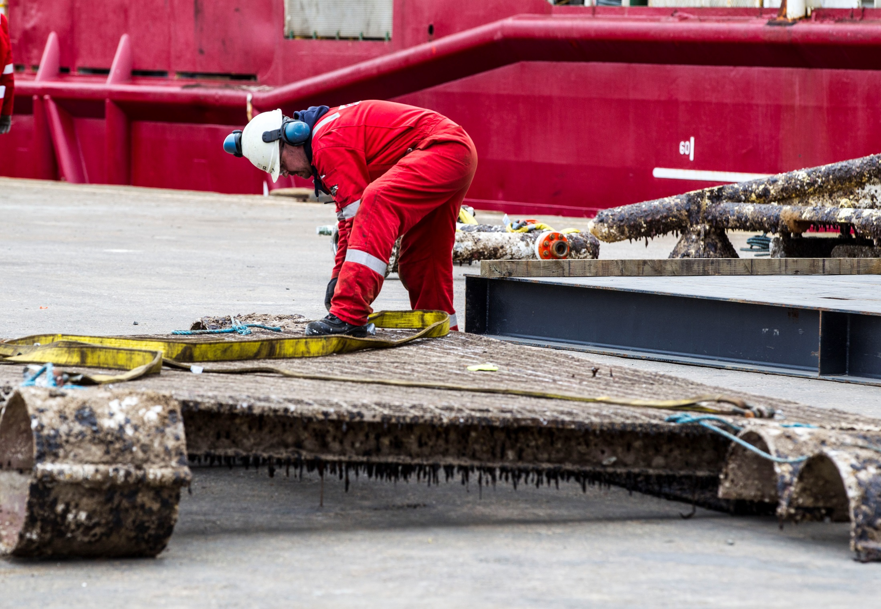
Thank You www.dundeecom.co.uk

