Slide 1

CONNECTING
CAPABILITY WITH OPPORTUNITY

Slide 2




Decom North Sea
Outlook for North Sea Decommissioning
Pamela Ogilvie, Business Manager
Decom North Sea

Slide 3

Decom North Sea, since 2010
Single topic, multi region membership organisation focussed on the late life and decommissioning value chain.
Global membership of over 400
23 operator members
Contractors from across the supply chain
Facilitate collaborative relationships and activities
Help minimise decommissioning costs
Ensure robust supply chain
Maximise business opportunities for our members
Alignment with OGA, DBEIS, Oil & Gas UK plus other UK and International organisations

Slide 4


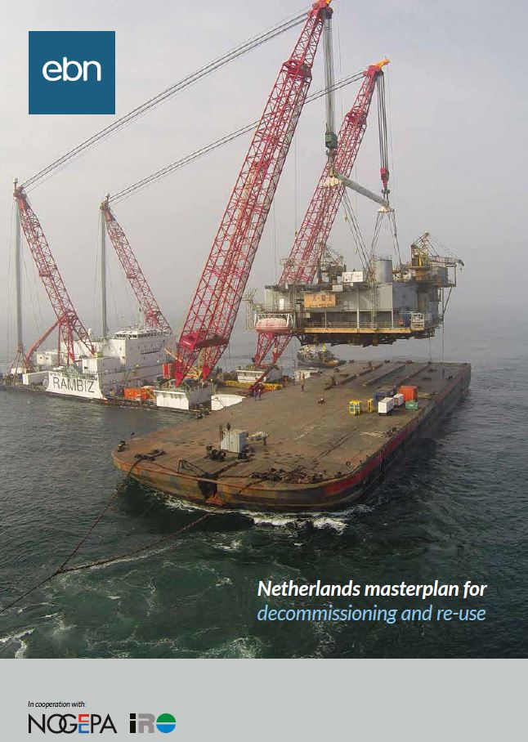
Single Topic, Multi Region
"A good idea should be connected; not protected”

Slide 5

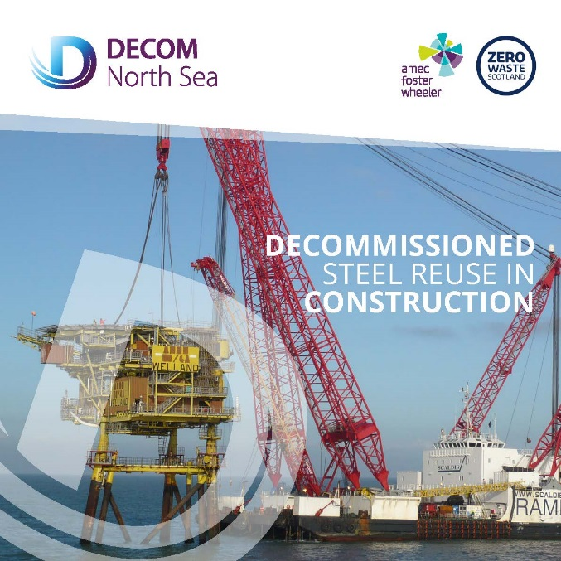
Single Topic, Multiple Sources of Information
"A good idea should be connected; not protected”

Slide 6
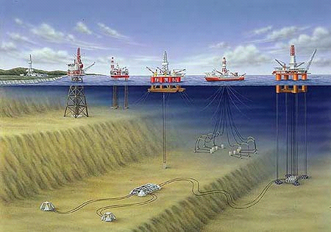
Decommissioning – What gets taken away?
Topsides
Onshore
Recycling
Jackets
Platform
Pipelines
Conductors
Manifolds/SSIVs/
Christmas trees
Mattresses
Wells

Slide 7
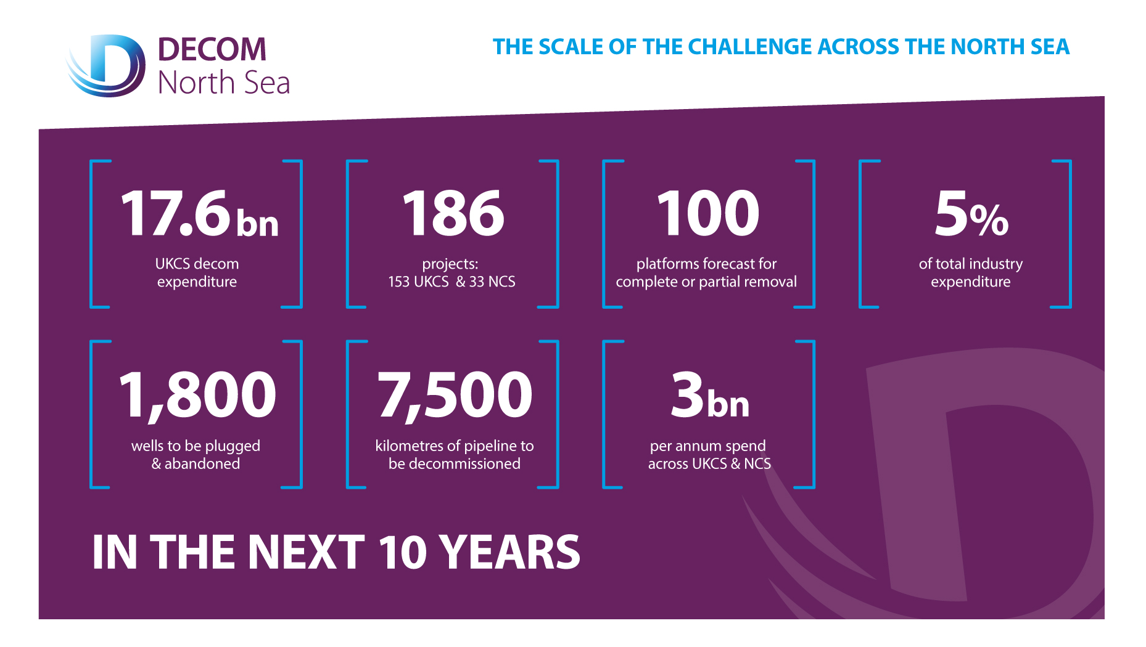

Slide 8
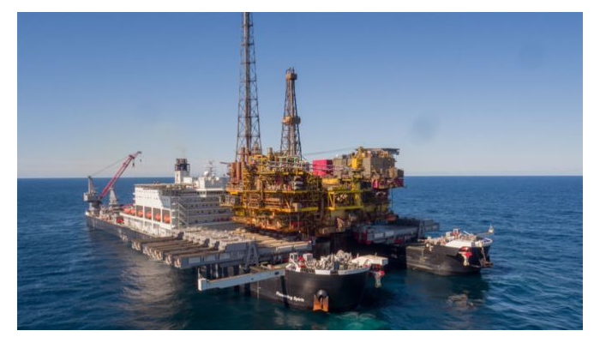

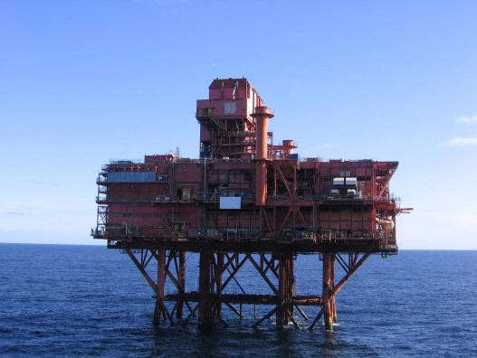
Reflection on Decommissioning

Slide 9
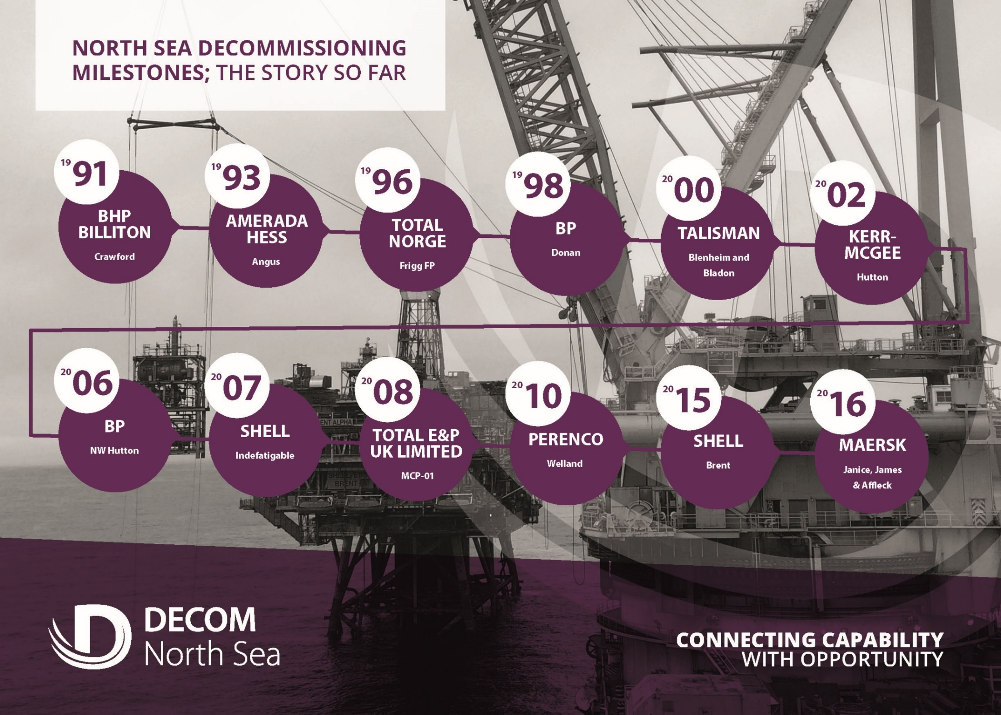

Slide 10
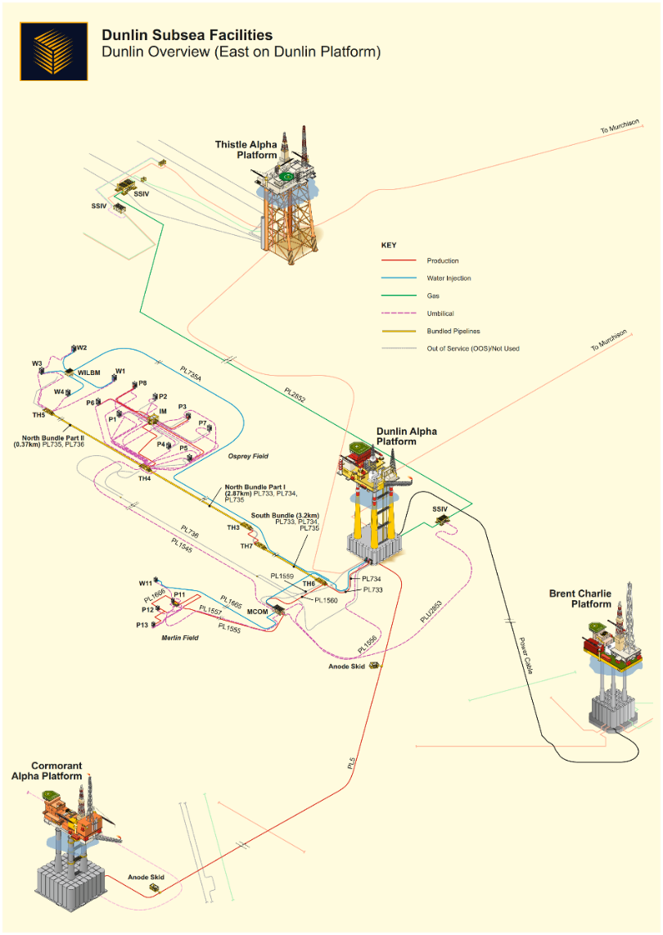
Active Decommissioning Projects
Armada
Atlantic and Cromarty Fields
Big Dotty
Brae Area
Brent
Dawn
Devenick
Don
Dunlin
Ettrick/Blackbird

Slide 11
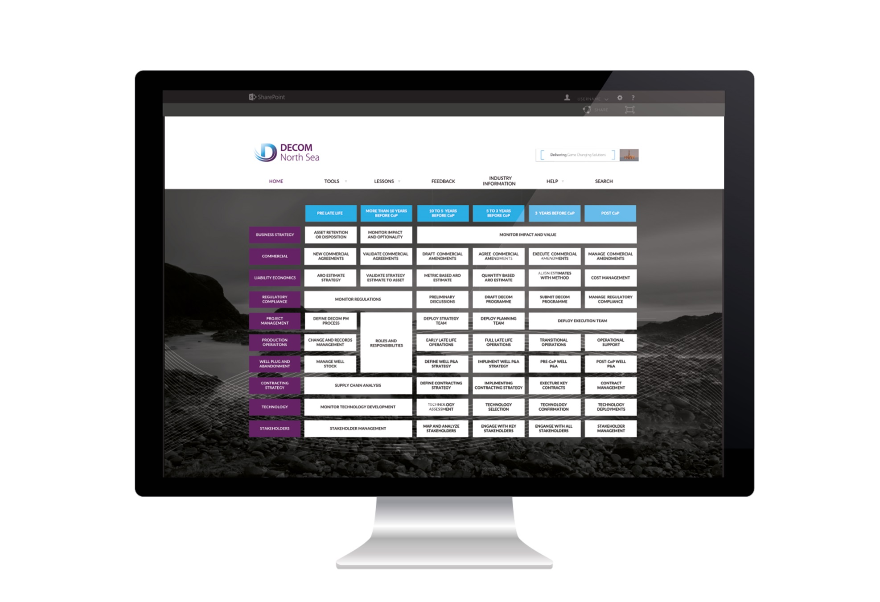
www.L2P2.net

Slide 12
Forthcoming Events
Lunch and Learn
  21 June, Village Hotel, Aberdeen
SPE Offshore Europe 2017 – Decom Zone 2017
  5-6 September, Aberdeen Exhibition and Conference Centre
Offshore Decommissioning Conference – Save the Date
  27-29 November, The Fairmont Hotel, St Andrews

Slide 13
Thank You

